Slide 1
Seek a location for Italian restaurants
Capstone Project The Battle of the Neighborhoods

Slide 2
Background and Introduction
London is one of the most prosperous and cultural city in the world. It had very developed service sectors.
it is no wonder that someone wants to open a new Italian restaurant in the center of London to catch the trend and make a lot of money
This project aims at finding the optimal selection for a new-opened Italian restaurant in the London city center. The core factors to influence our decision are the number of restaurants, number of Italian restaurant and the distance to the city center.

Slide 3
Data acquisition and cleaning
number of restaurants existing in the neighborhoods(geopy library )
number of similar Italian restaurants in the neighborhoods(Foursquare API)
distance of neighborhoods from city center(Foursquare API)

Slide 4
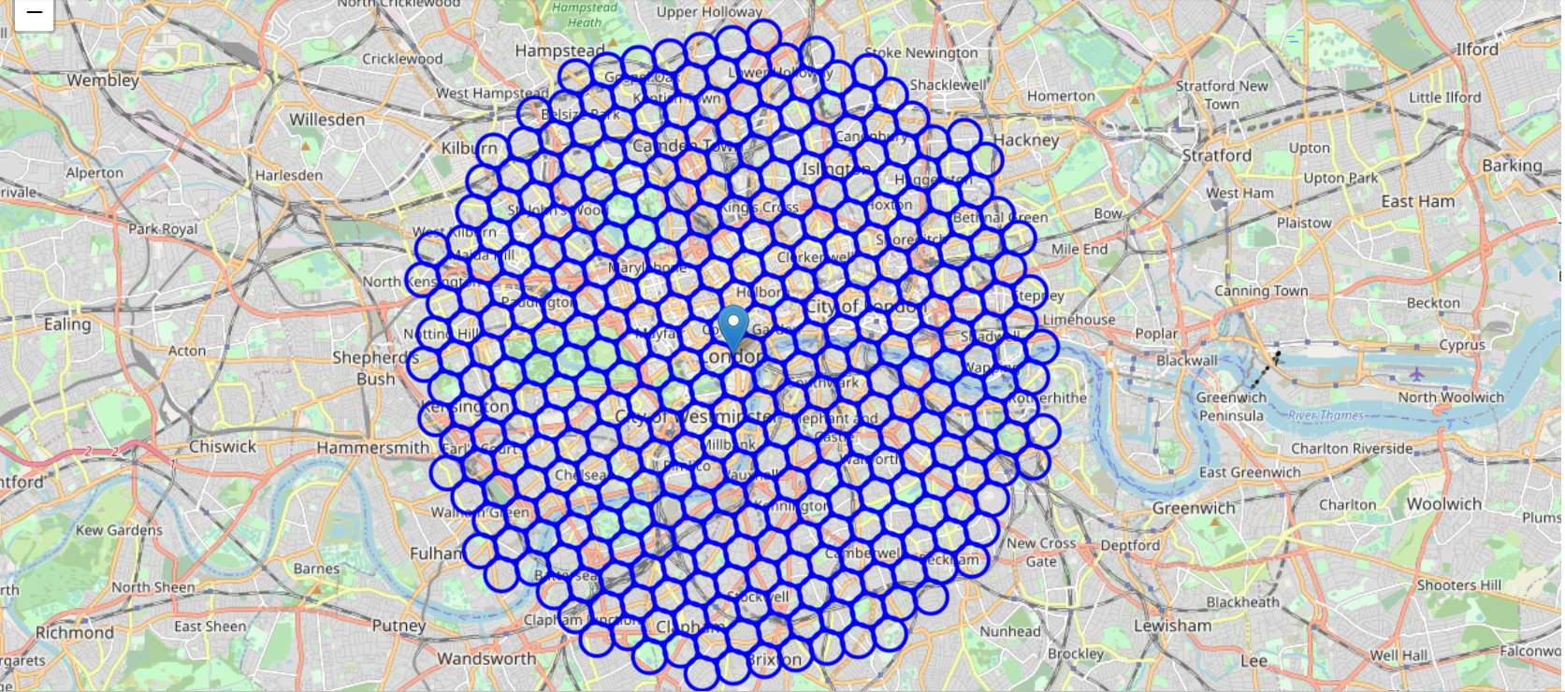
city center location and candidate neighborhood centers

Slide 5
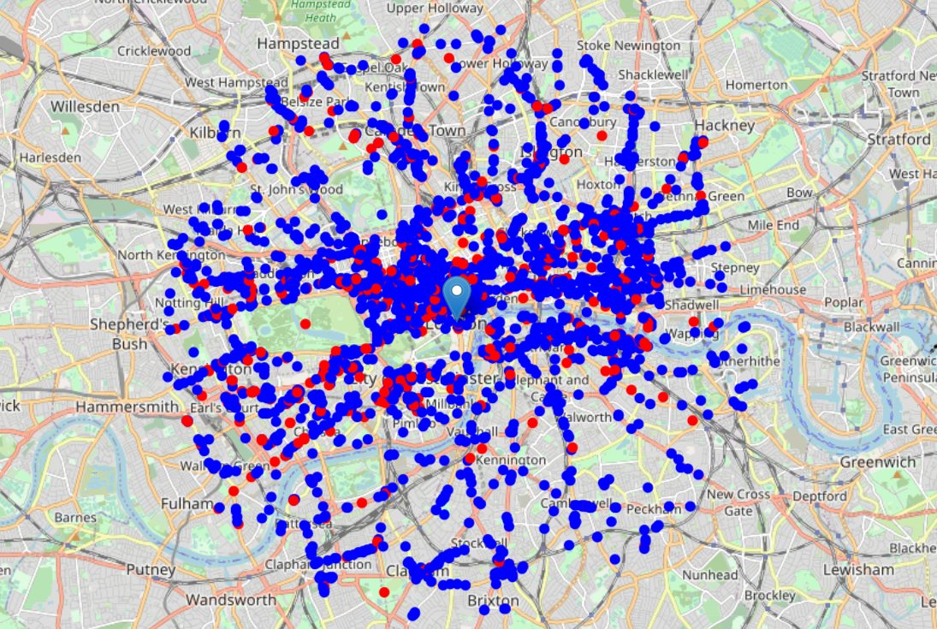
restaurants in the city center and the Italian restaurants(red points)

Slide 6
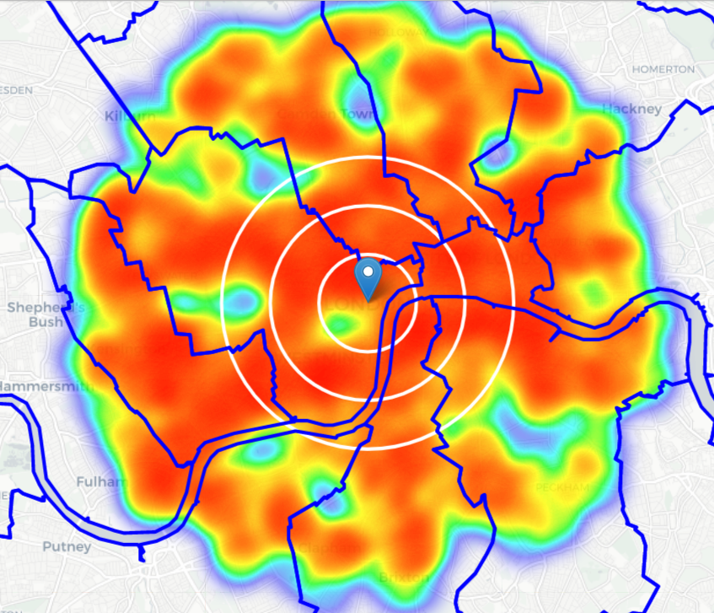
density of restaurants and also the borders of London borough
It seems south and south east of London center has the lowest of restaurants

Slide 7
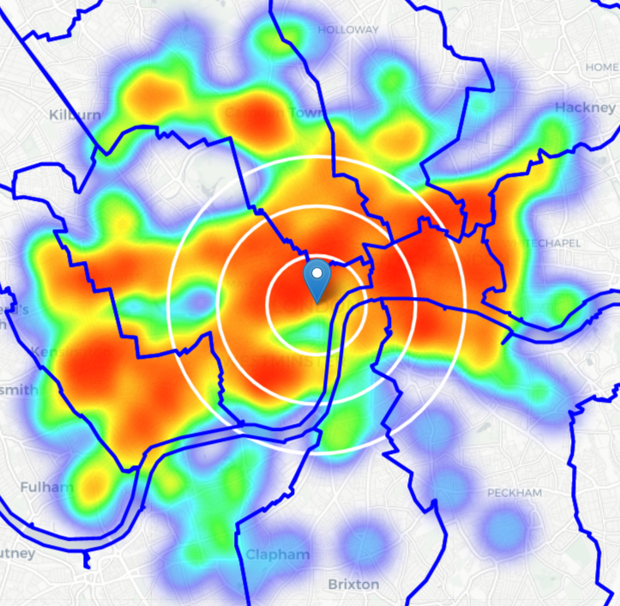
Density of Italian restaurants
This map shows the consistency with last map

Slide 8
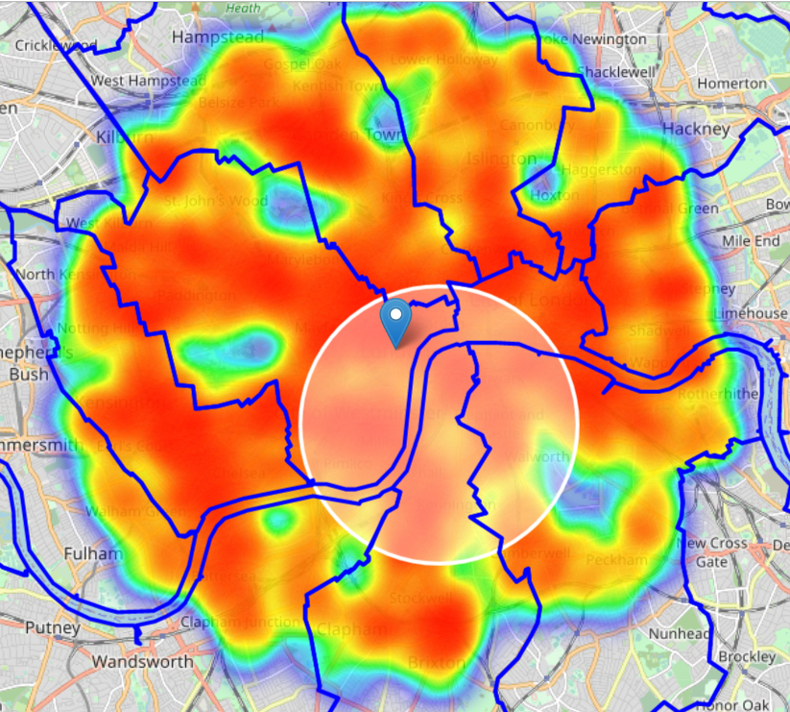
low-restaurant-count parts of Pimlico and Kennington
Pimlico and Kennington these two area in London have the lowest restaurants and Italian restaurants nearby

Slide 9
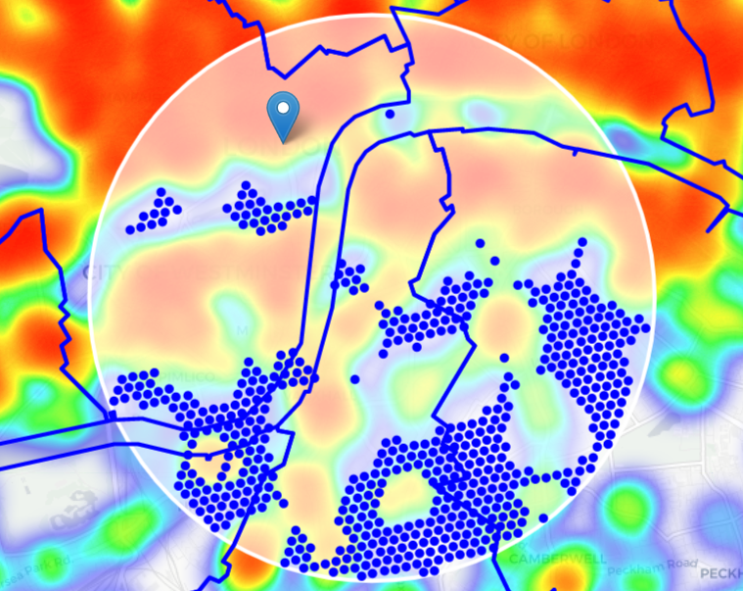
zones with low number of restaurants in vicinity, and no Italian restaurants at all nearby.

Slide 10
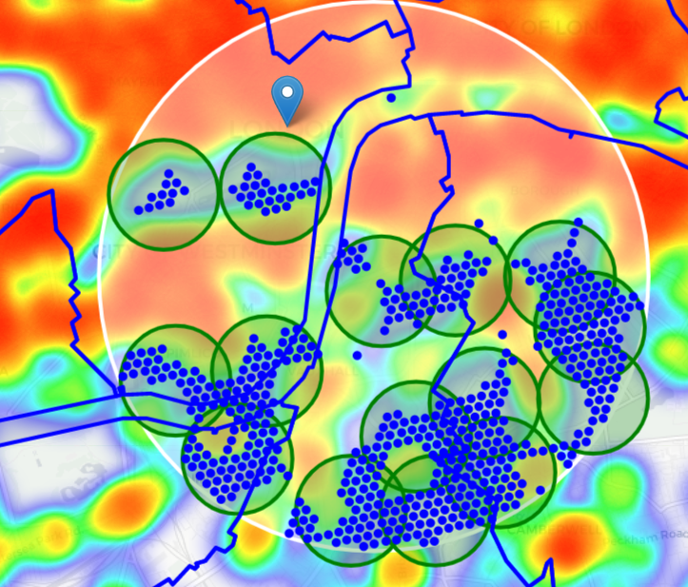
Cluster analysis
Here it has 15 clusters for the selection of stakeholders

Slide 11
Addresses of centers of areas recommended for further analysis
ARK All Saints Academy, 140, Wyndham Road, Wyndham and Comber Estate, Camberwell, London Borough of Southwark, London, Greater London, England, SE5 0UB, United Kingdom => 3.7km from London
Blackstone House, Glasgow Terrace, Pimlico, City of Westminster, London, Greater London, England, SW1V 3AB, United Kingdom => 2.5km from London
West Square, Borough, Elephant and Castle, London Borough of Southwark, London, Greater London, England, SE11, United Kingdom => 2.1km from London
English Martyrs' Catholic Primary School, Elsted Street, Bermondsey Spa, Walworth, London Borough of Southwark, London, Greater London, England, SE17, United Kingdom => 3.3km from London
Foreign and Commonwealth Office, 30, King Charles Street, Westminster, Millbank, City of Westminster, London, Greater London, England, SW1A 2AH, United Kingdom => 0.6km from London
Hampson Way, Stockwell, London Borough of Lambeth, London, Greater London, England, SW8 1HZ, United Kingdom => 3.6km from London

Slide 12
Addresses of centers of areas recommended for further analysis
Michael Faraday Primary School, Portland Street, Borough, Walworth, London Borough of Southwark, London, Greater London, England, SE17, United Kingdom => 3.8km from London
Ponton Road, Nine Elms, London Borough of Wandsworth, London, Greater London, England, SW11 7BA, United Kingdom => 3.1km from London
Buckingham Palace Garden, Duke of Wellington Place, St. James's, Belgravia, City of Westminster, London, Greater London, England, SW1X 7SH, United Kingdom => 1.3km from London
Globe Academy, Harper Road, Borough, Walworth, London Borough of Southwark, London, Greater London, England, SE1 6AG, United Kingdom => 2.9km from London
Purple Jay Nursery, Juxon Street, South Bank, Lambeth, London Borough of Lambeth, London, Greater London, England, SE11 6NH, United Kingdom => 1.7km from London
Brixton Road, Kennington, London Borough of Lambeth, London, Greater London, England, SE11 5TP, United Kingdom => 3.1km from London
Lorrimore Square, Borough, Elephant and Castle, London Borough of Southwark, London, Greater London, England, SE17 3QU, United Kingdom => 3.1km from London
Christ Church Primary, Cancell Road, Kennington, London Borough of Lambeth, London, Greater London, England, SW9 6HN, United Kingdom => 3.8km from London

Slide 13
Conclusion
we have first identified general boroughs that justify further analysis (Pimlico and Kennington),
then generated extensive collection of locations which satisfy some basic requirements regarding existing nearby restaurants
Clustering of those locations was then performed in order to create major zones of interest
Final decision on optimal restaurant location will be made by stakeholders based on specific characteristics of neighborhoods and locations in every recommended zone

